Slide 1
Op-Amp Applications
Electronic Devices and Circuit Theory
Boylestad
Chapter 11

Slide 2
Ch.11 Summary
Common Op-Amp Applications
Constant-gain amplifier
Voltage summing
Voltage buffer
Controlled sources
Instrumentation circuits
Active filters

Slide 3
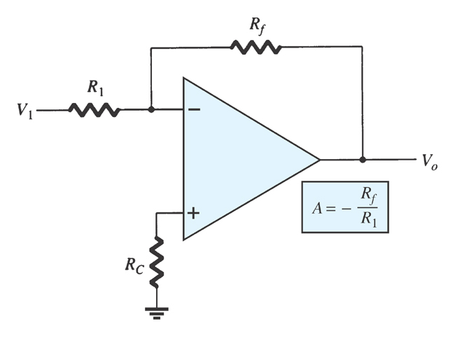
Ch.11 Summary
Constant-Gain Amplifier
Inverting amplifier

Slide 4
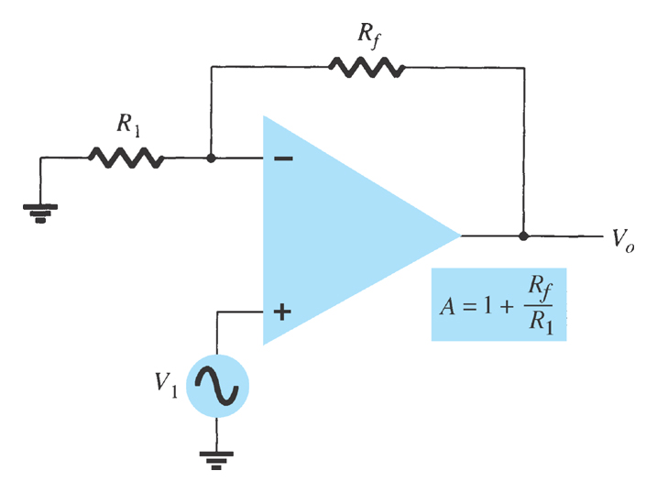
Ch.11 Summary
Constant-Gain Amplifier
Noninverting amplifier
Noninverting amplifier

Slide 5

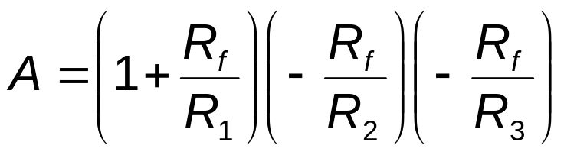
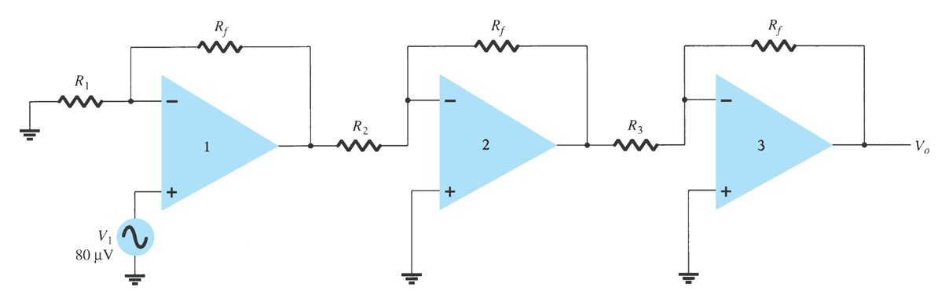
Ch.11 Summary
Multiple-Stage Gains
The total gain (3-stages) is given by:
or:

Slide 6
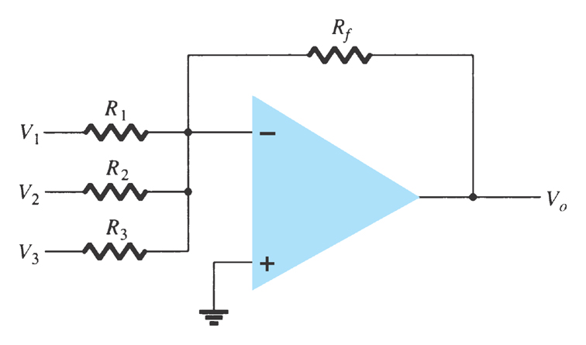
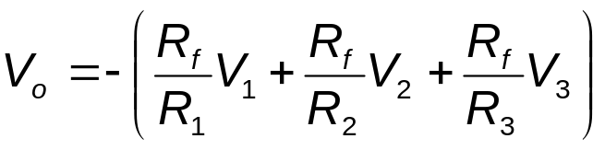
Ch.11 Summary
Voltage Summing
The output is the sum of individual signals times the gain:

Slide 7
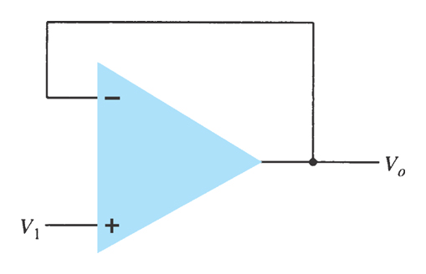
Ch.11 Summary
Voltage Buffer
Any amplifier with no gain or loss is called a unity gain amplifier.
The advantages of using a unity gain amplifier:
  Very high input impedance
  Very low output impedance
The unity gain amplifier shown is commonly referred to as a voltage buffer or a voltage follower.

Slide 8
Ch.11 Summary
Controlled Sources
  Voltage-controlled voltage source Voltage-controlled current source Current-controlled voltage source Current-controlled current source

Slide 9
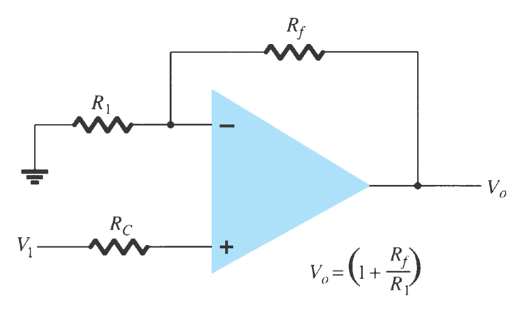
Ch.11 Summary
Voltage-Controlled Voltage Source
The output voltage equals the gain times the input voltage.
Noninverting Amplifier Version
What makes an op-amp different from other amplifiers is that its impedance characteristics and gain calculations depend solely on external resistors.

Slide 10
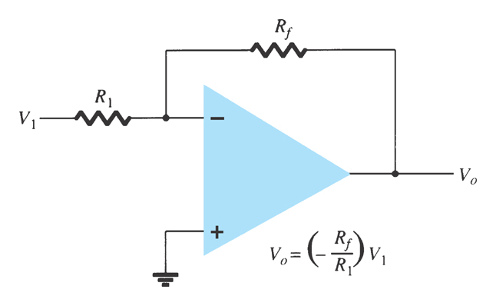
Ch.11 Summary
Voltage-Controlled Voltage Source
The output voltage equals the gain times the input voltage.
Inverting Amplifier Version
Like the noninverting amplifier configuration, its impedance characteristics and gain calculations depend solely on external resistors.

Slide 11
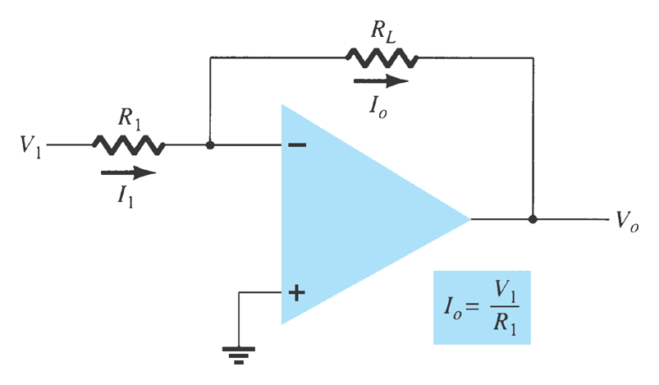
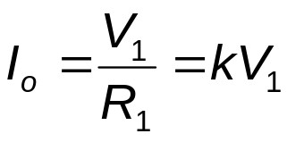
Ch.11 Summary
Voltage-Controlled Current Source
The output current is:

Slide 12
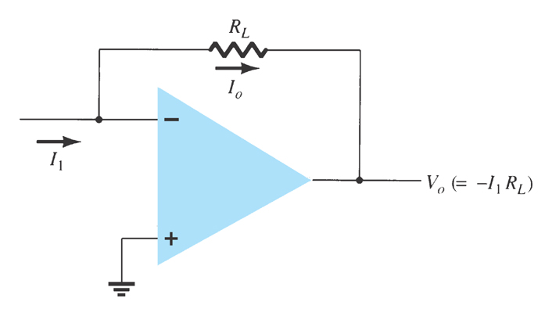
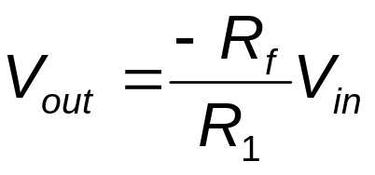

Ch.11 Summary
Current-Controlled Voltage Source
This is simply another way of applying the op-amp operation. Whether the input is a current determined by V_{in}/R₁ or as I₁:
or

Slide 13
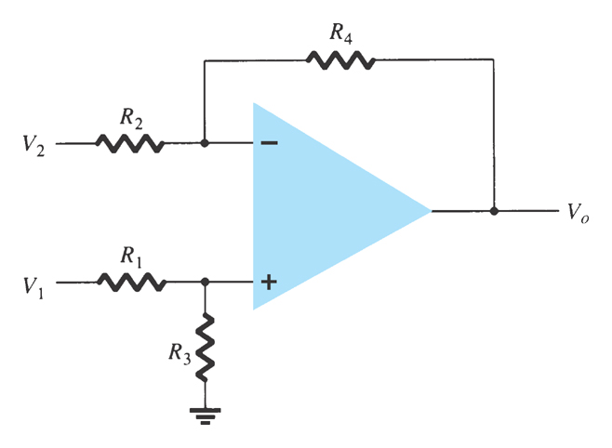
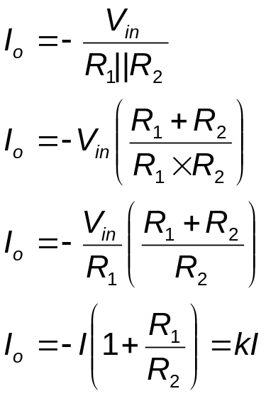
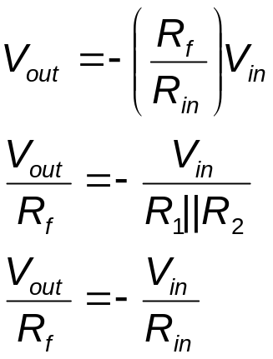
Ch.11 Summary
Current-Controlled Current Source
This circuit may appear more complicated than the others but it is really the same thing.

Slide 14
Ch.11 Summary
Instrumentation Circuits
Some examples of instrumentation circuits using op-amps:
  Display driver
  Instrumentation amplifier

Slide 15
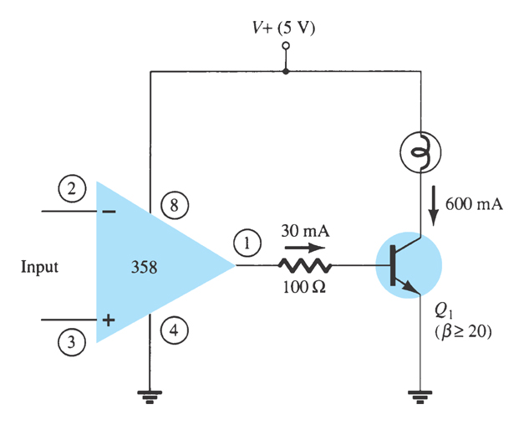
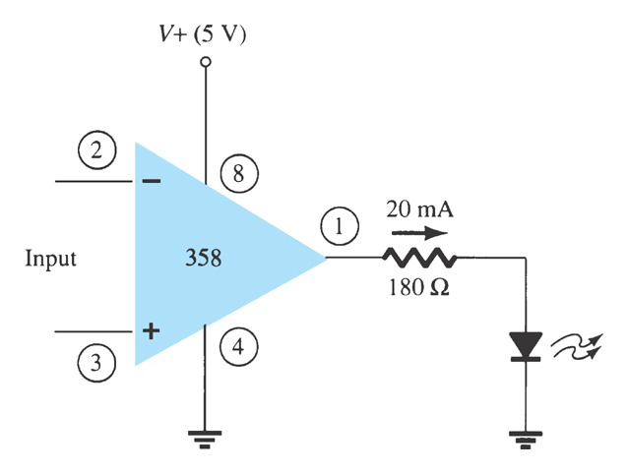
Ch.11 Summary
Display Driver

Slide 16
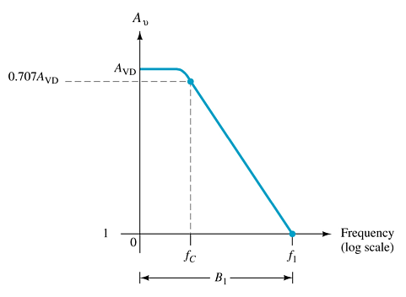
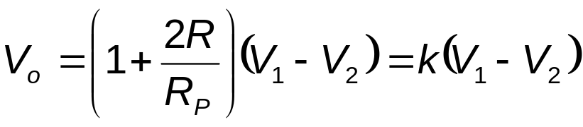
Ch.11 Summary
Instrumentation Amplifier
For all resistors at the same
value (except R_{p}):

Slide 17
Ch.11 Summary
Active Filters
Adding capacitors to op-amp circuits provides external control of the cutoff frequencies. The op-amp active filter has controllable cutoff frequencies and controllable gain.
  Low-pass filter
  High-pass filter
  Bandpass filter

Slide 18
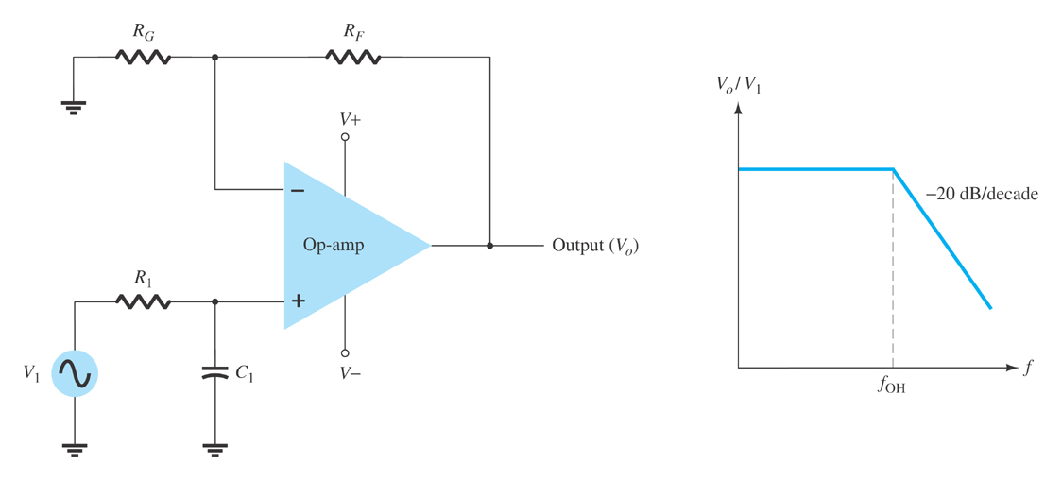
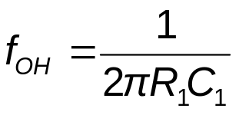
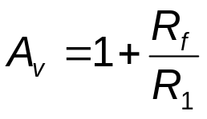
Ch.11 Summary
Low-Pass Filter, First-Order
The upper cutoff frequency and voltage gain are given by:

Slide 19
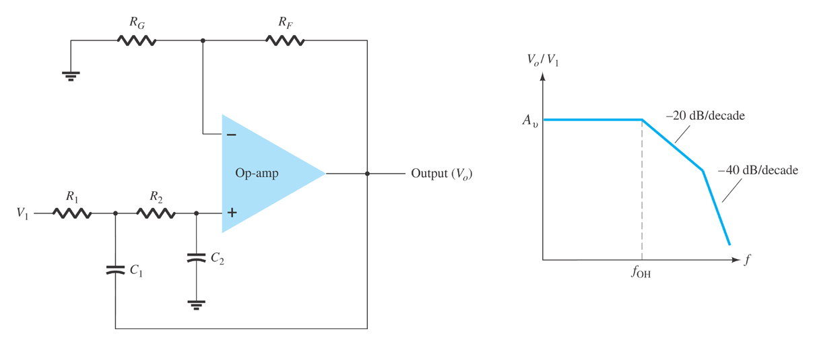
Ch.11 Summary
Low-Pass Filter, Second-Order
The roll-off can be made steeper by adding more RC networks.

Slide 20
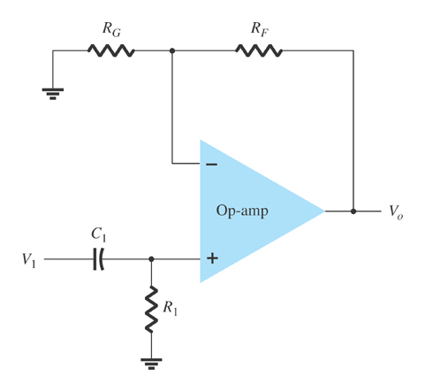
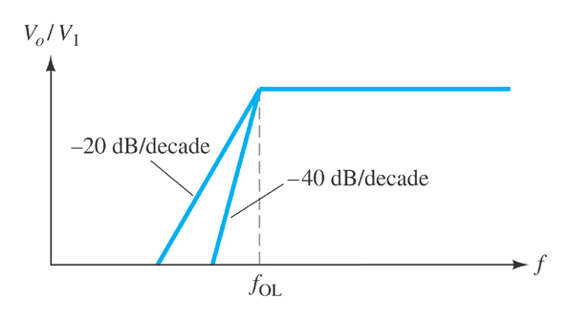
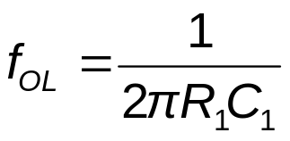
Ch.11 Summary
High-Pass Filter
The cutoff frequency is determined by:

Slide 21
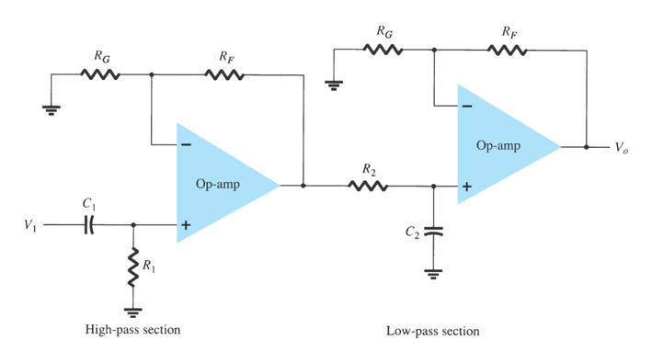
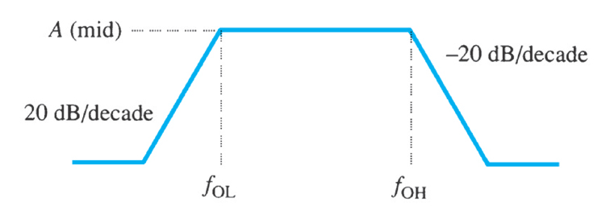
Ch.11 Summary
Bandpass Filter
There are two cutoff frequencies: upper and lower. They can be calculated using the same low-pass cutoff and high-pass cutoff frequency formulas in the appropriate sections.

